Slide 1
Clippd✂️
Team A
EunHyuk Doo | Isaac Hur | Kwesi Mireku | Swayam Shrestha | Ted Turnage
Notes:
Roles:
Ted: Vision, key user stories
Isaac/Swayam: Domain and Design
Kwesi: App demonstration
Kai: Narrating demo, Status report
Structure:
Vision
Analysis and Design
Domain model
UI model
Key user stories
Information systems design
Demo
Status Report
Q&A
Professor wants Ted’s freshman pic as a hook to grab attention

Slide 2
Vision
Notes:
Customer Side
Login
Scroll the homepage
Use Help (?) if needed
Click a clipper
Leave a comment or add to favorites
Check if clipper was added to favorites
Use Search / Filters (example: Buzz Cut)
Open the map
See clippers near your location
Tap and hold a clipper icon to show the clippers details
Go to Profile
Edit profile picture
Update preferences
Log out
Clipper Side
Login
Use Help (?)
Edit profile
Services
Portfolio photos
Read customer reviews
View clipper homepage
See other clippers
Compare services
Show the profile changes you made reflected on the homepage

Slide 3
Product Demo
Notes:
Customer Side
Login
Scroll the homepage
Use Help (?) if needed
Click a clipper
Leave a comment or add to favorites
Check if clipper was added to favorites
Use Search / Filters (example: Buzz Cut)
Open the map
See clippers near your location
Tap and hold a clipper icon to show the clippers details
Go to Profile
Edit profile picture
Update preferences
Log out
Clipper Side
Login
Use Help (?)
Edit profile
Services
Portfolio photos
Read customer reviews
View clipper homepage
See other clippers
Compare services
Show the profile changes you made reflected on the homepage

Slide 4
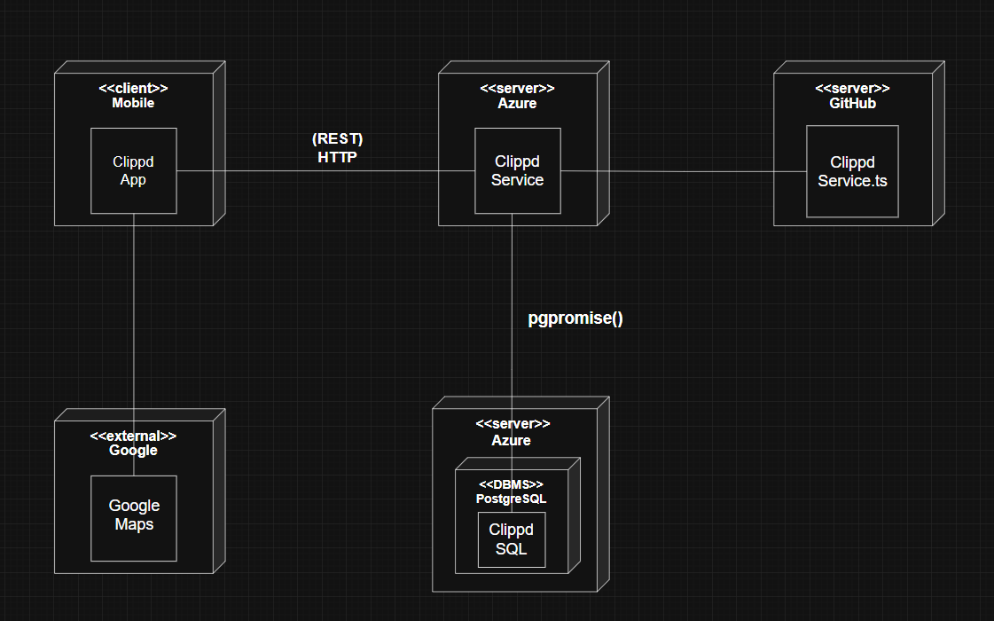
..*
(REST)
HTTPS

Slide 5
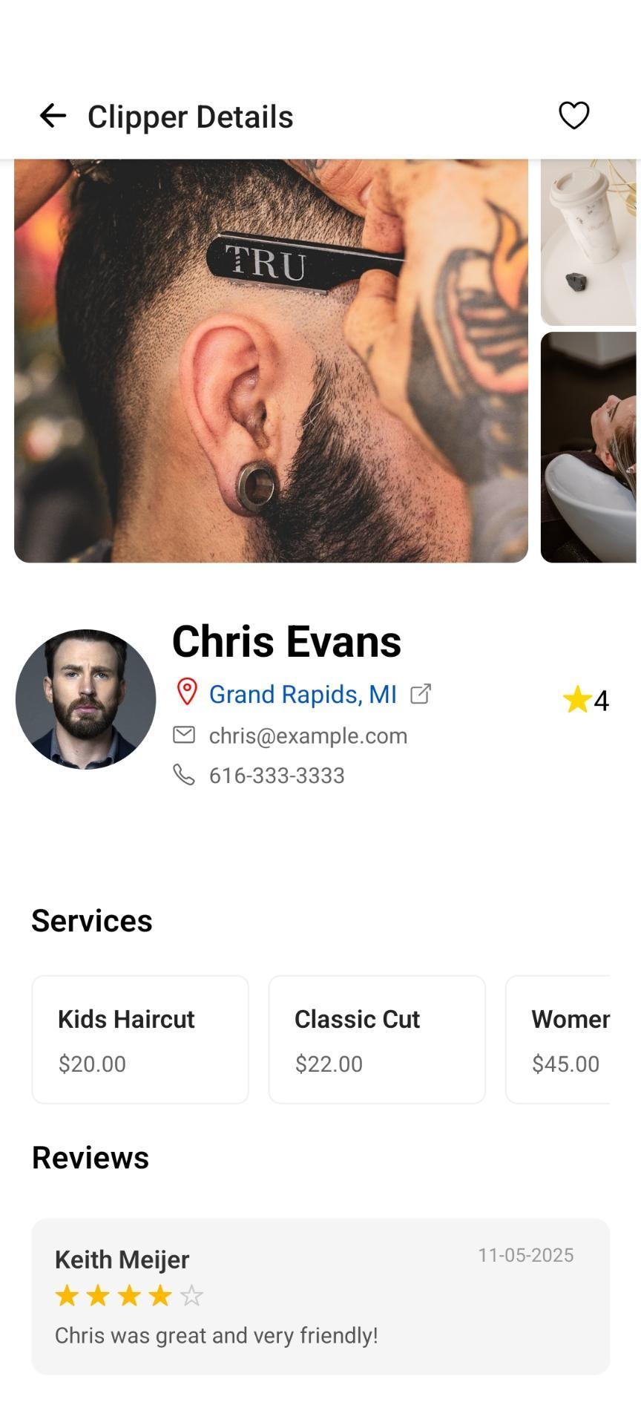
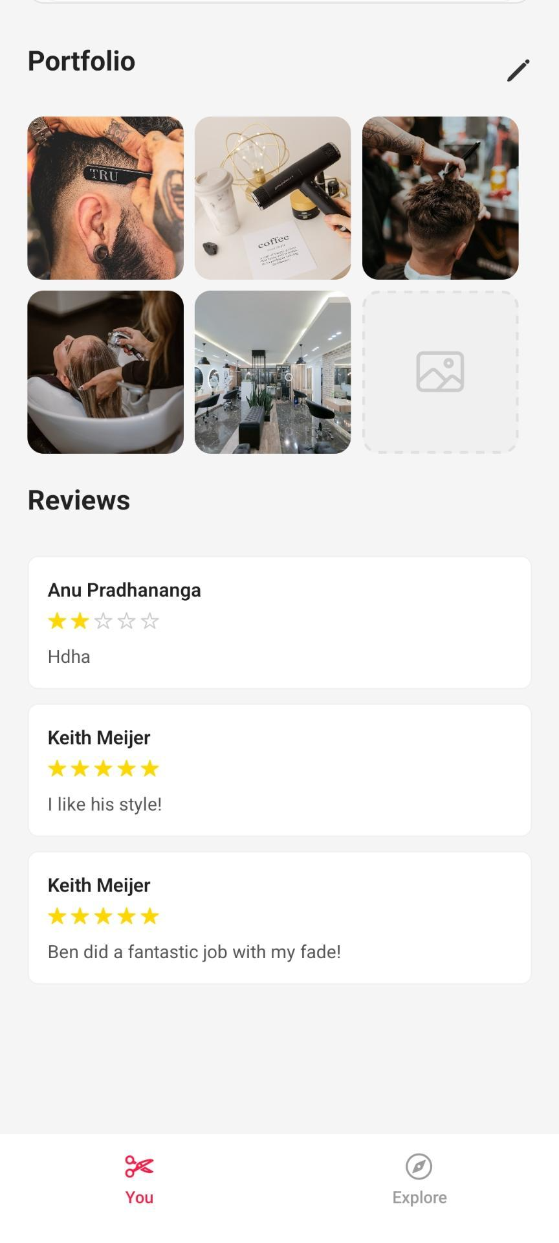

Slide 6

Functionality
Strengths
Live data from our database
Unique Design
Fast responsive time
Weaknesses
Private Information
Map, Filter & Signup

Slide 7
Future
Prospects
Booking System
Map
Filter
Sign Up
Notes:
Private Information → Booking system
Map - be able to see all the Clippers around you and filter base off the radius
Filter - we have too much options to choose from - decide whether to decrease or not
Signup - works partially.

Slide 8
Societal / Ethical
Implications
Notes:
Societal Implications: Postman Idea No.2. There are winners and losers.
Clippers (Winners) who are familiar with:
Social media self-branding
Photography & short-form video
Other algorithmic engagement (ratings, response time, posting cadence)
❌ Losers
Anyone who:
Lacks digital literacy
Is uncomfortable with self-promotion
Why This Matters (Postman’s Core Warning)
This isn’t just about using an app.
It’s about a cultural shift in what counts as “good”:
Old Measure New Measure
Long-term reputation Star rating
Client loyalty Engagement metrics
The app silently redefines excellence. That re-definition is the cost of the technology.
This can lead to Postman’s 4th idea: tech is ecological, not additive.
To address this, we will encourage clippers to edit their bio +
Clippers be able to add replies on the reviews itself to provide background context

Slide 9

Ask us anything!

Slide 10
Future Prospects
Private Information
Map
Filter
Signup
Notes:
Private Information → Booking system
Map - be able to see all the Clippers around you and be able to proceed booking from there
Filter - we have too much options to choose from - decide whether to decrease or not
Signup - works partially.

Slide 11
